Slide 1
15-440 Distributed Systems
11 - Fault Tolerance, Logging and Recovery
Tuesday, Oct 2nd, 2018

Slide 2
Logistics Updates
P1 Part A checkpoint
Part A due: Saturday 10/6 (6-week drop deadline 10/8)
*Please WORK hard on it!*
HW2 will be released 10/02
HW 2 due: Friday 10/12
Midterm-I – 10/18, 10:30 - Noon (details to follow)
Midterm-I – Review on 10/16 in class.
Midterm-II – 12/06 (mostly confirmed), in class

Slide 3
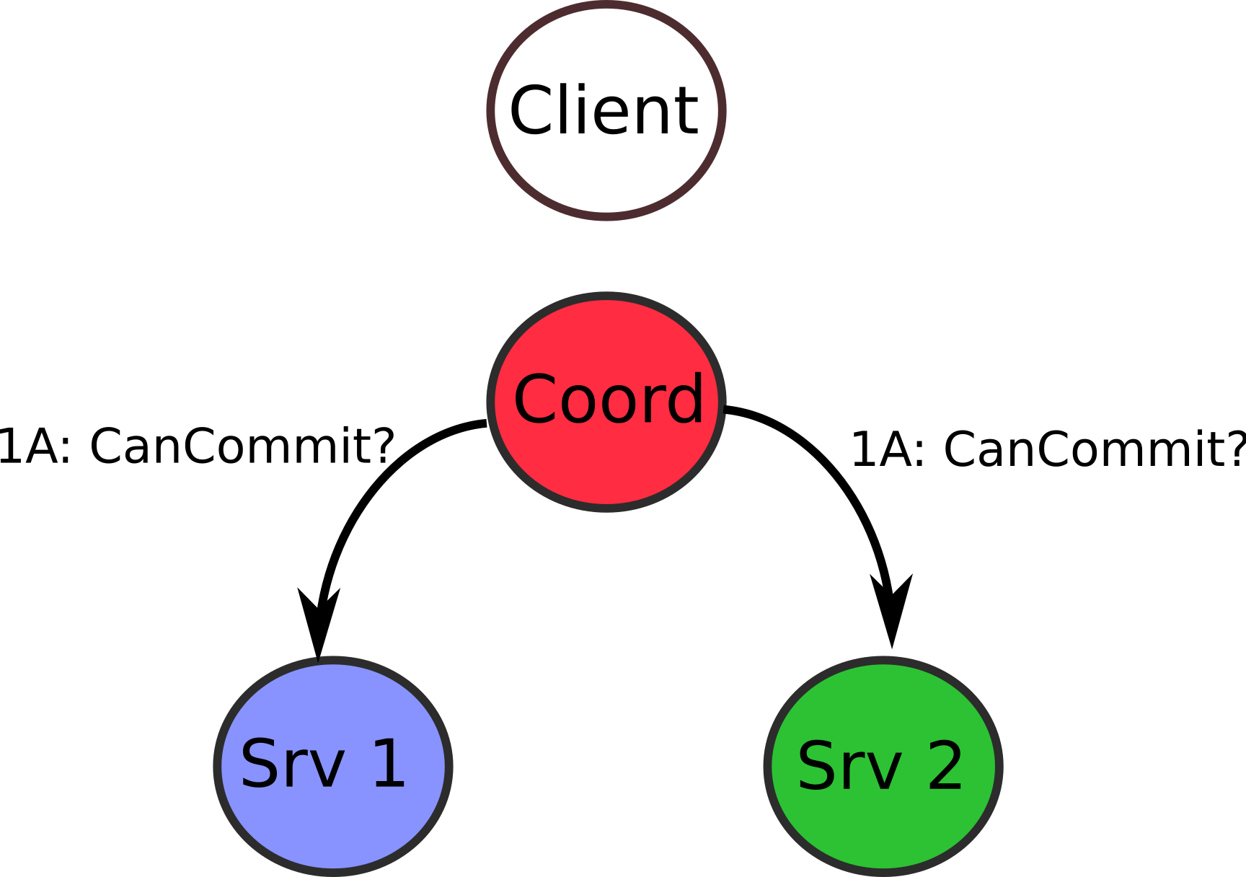
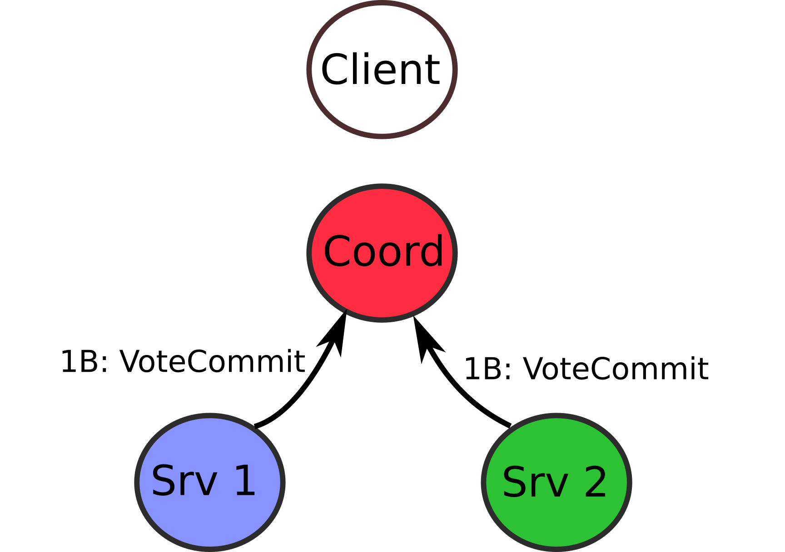
Recap: Last Lecture
ACID Properties
Atomicity, Consistency, Isolation, Durability
2-Phase Commit for distributed transactions
2PC assumptions:
Coordinator
Ability to recover state, persistence after “DoCommit”

Slide 4
Today's Lecture Outline
Motivation – Fault Tolerance
Fault Tolerance using Checkpoints
Fault Tolerance using Logging and Recovery
Logging and Recovery in Practice: ARIES
Notes:
Userful References:
https://en.wikipedia.org/wiki/Algorithms_for_Recovery_and_Isolation_Exploiting_Semantics
https://en.wikipedia.org/wiki/Write-ahead_logging
https://en.wikipedia.org/wiki/Shadow_paging

Slide 5
What is Fault Tolerance?
Dealing successfully with partial failure within a distributed system
Fault tolerant ~> dependable systems
Dependability implies the following:
Availability
Reliability
Safety
Maintainability
Notes:
Question: what’s a partial failure? Some nodes in a DS are down / error / unresponsive -- however they all are part of the shared state.

Slide 6
Dependability Concepts
Availability – the system is ready to be used immediately.
“High availability”: system is ready at any given time, with high probability.
Reliability – the system runs continuously without failure.
“High reliability”: system works without interruption during a long period of time.
Subtle difference. Consider:
Random but rare failures (one millisecond every hour)
Predictable maintenance (two weeks every year)
Notes:
To differentiate between avaiability and reliability:
A system that goes down for 1ms every hour has avaiability of 99.9999% (six 9’s) but that’s not realiable.
A system that never crashes or goes down, but is shut off for 2 weeks every august has availability of 96% but its super reliable.
Maintainability or the process of being able to recover from an error is a key part of a DS.
Transient Fault – appears once, then disappears.
Intermittent Fault – occurs, vanishes, reappears; but: follows no real pattern (worst kind).
Permanent Fault – once it occurs, only the replacement/repair of a faulty component will allow the DS to function normally.

Slide 7
Dependability Concepts
Safety – if a system fails, nothing catastrophic will happen. (e.g. process control systems)
Maintainability – when a system fails, it can be repaired easily and quickly (sometimes, without its users noticing the failure). Also called Recovery.
What’s a failure? : System that cannot meet its goals => faults
Recover from all kinds of faults:
Transient: appears once, then disappears
Intermittent: occurs, vanishes, reappears
Permanent: requires replacement / repair
Notes:
To differentiate between avaiability and reliability:
A system that goes down for 1ms every hour has avaiability of 99.9999% (six 9’s) but that’s not realiable.
A system that never crashes or goes down, but is shut off for 2 weeks every august has availability of 96% but its super reliable.
Maintainability or the process of being able to recover from an error is a key part of a DS.
Transient Fault – appears once, then disappears.
Intermittent Fault – occurs, vanishes, reappears; but: follows no real pattern (worst kind).
Permanent Fault – once it occurs, only the replacement/repair of a faulty component will allow the DS to function normally.

Slide 8
Failure Models
Type of Failure | Description
Crash failure | Server halts, working correctly before.
Omission failure Receive omission Send omission | Server fails to respond to request Server fails to receive incoming msg Server fails to send msg
Timing failure | Server’s response outside specified time interval
Response failure Value failure State transition failure | Incorrect server response Wrong value of response Deviation from flow of control
Arbitrary (Byzantine) failure | Server may produce arbitrary responses at arbitrary times

Slide 9
Masking Failures by Redundancy
Information Redundancy – add extra bits to allow for error detection/recovery
(Hamming codes: detect 2-bit errors, correct 1-bit errors)
Time Redundancy – perform operation and, if needs be, perform it again.
(Purpose of transactions: BEGIN/END/COMMIT/ABORT)
Physical Redundancy – add extra (duplicate) hardware and/or software to the system.
Can you think of Physical redundancy in Nature?
Notes:
Information Redundancy: Hamming Codes,
Can you think about physical redundancy in nature?
Humans: 2 lungs, 2 kidneys, 2 ears, 2 eyes?

Slide 10
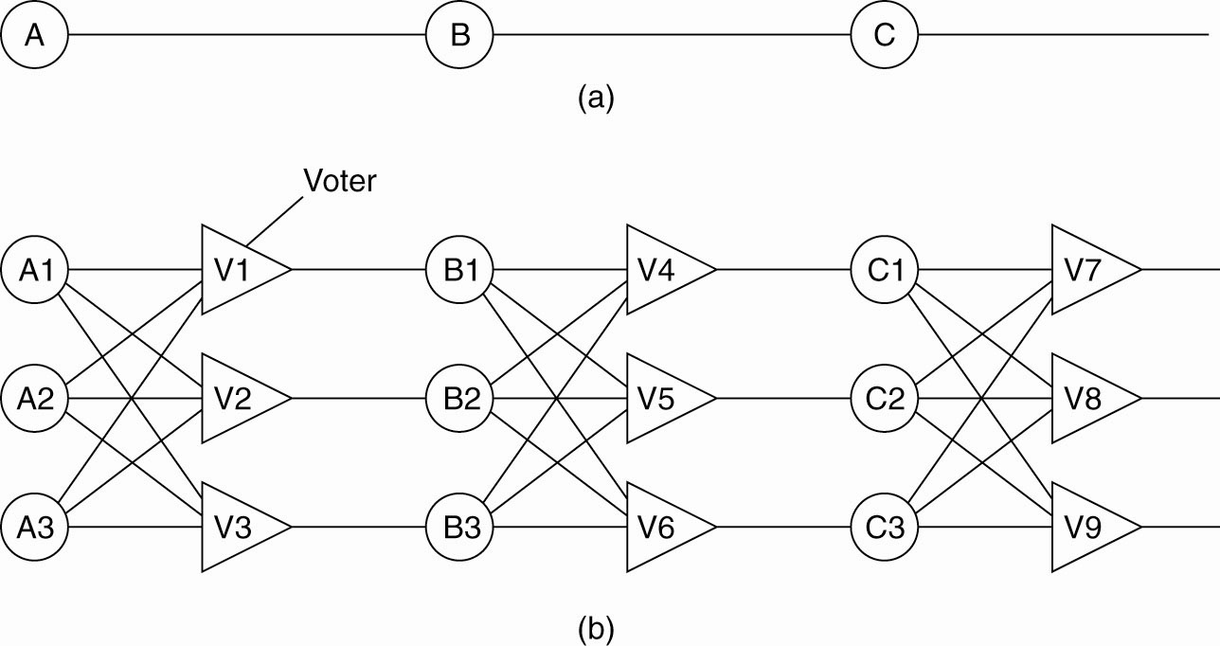
Redundancy in Electronics
Triple modular redundancy in a circuit (b)
A,B,C are circuit elements and V* are voters
Notes:
Question: Why do you think we need three voters rather than a single voter (i.e. Just V1 instead of V1, V2, V3?).
Answer: What if the voter component is itself faulty?
Question: Why 3 voters and not 2?
Answer: Well, we need to tie break :-)

Slide 11
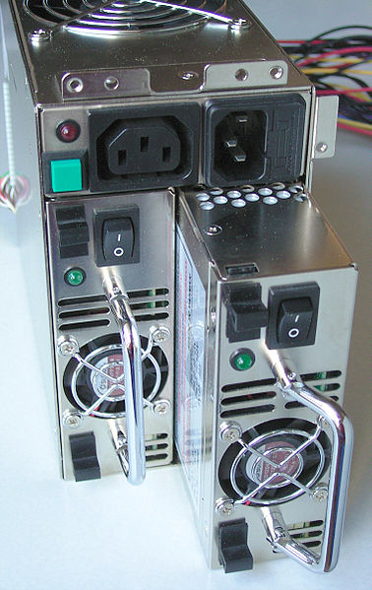
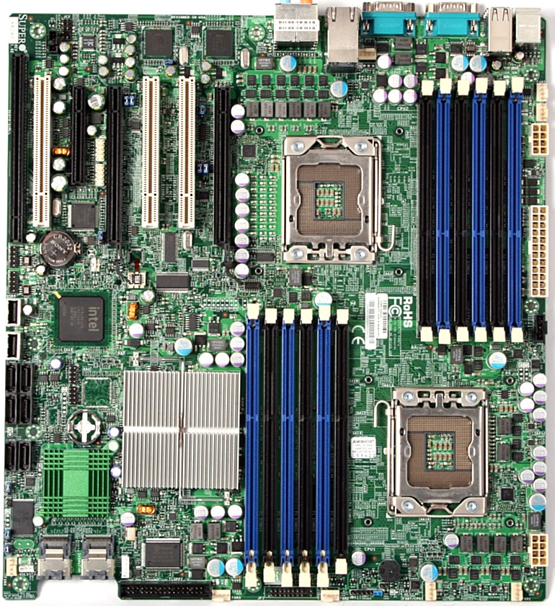
Redundancy is Expensive
But without redundancy, we need to recover after a crash.
Notes:
Backward error Recovery Example: Packet retransmission in case of a lost packet. (earlier state was when the lost packet was just about to be sent)
Forward error recovery is for example Erasure correction. (n,k) erasure code means k source packets are encoded in n encoded packets such that any set of k packets can be used to reconstruct the original k packets. Typically k = 16,32 while <k<n<=2k.
Backward Error recovery is more common. Forward Recovery requires that you know (and plan for) all failures apriori, which is often hard.

Slide 12
Today's Lecture Outline
Motivation – Fault Tolerance
Fault Tolerance using Checkpoints
Fault Tolerance using Logging and Recovery
Logging and Recovery in Practice: ARIES
Notes:
Userful References:
https://en.wikipedia.org/wiki/Algorithms_for_Recovery_and_Isolation_Exploiting_Semantics
https://en.wikipedia.org/wiki/Write-ahead_logging
https://en.wikipedia.org/wiki/Shadow_paging

Slide 13
Recovery Strategies
When a failure occurs, we need to bring the system into an error free state (recovery).
Backward Recovery: return the system to some previous correct state (using checkpoints), then continue executing.
Packet retransmit in case of lost packet
Forward Recovery: bring the system into a correct new state, from which it can then continue to execute.
Erasure coding → Forward Error Correction
Notes:
Backward error Recovery Example: Packet retransmission in case of a lost packet. (earlier state was when the lost packet was just about to be sent)
Forward error recovery is for example Erasure correction. (n,k) erasure code means k source packets are encoded in n encoded packets such that any set of k packets can be used to reconstruct the original k packets. Typically k = 16,32 while <k<n<=2k.
Backward Error recovery is more common. Forward Recovery requires that you know (and plan for) all failures apriori, which is often hard.

Slide 14
Forward and Backward Recovery
Major disadvantage of Backward Recovery:
Checkpointing can be very expensive (especially when errors are very rare).
Major disadvantage of Forward Recovery:
In order to work, all potential errors need to be accounted for up-front.
“Harder” the recovery mechanism need to know how do to bring the system forward to a correct state.
In practice: backward recovery common
Notes:
In practice Backward recovery is used more often.
Also, in practive the combination of having fewer checkpoints and having message logging is better than having many checkpoints.

Slide 15
Backward Recovery
Checkpoint: snapshot the state of the DS
Transactions
Messages received / sent
Roles like coordinator, …
Frequent checkpoints are expensive
Requires writing to stable storage
Very slow if checkpoint after every event!
What can we do to make checkpoints cheaper?
Less frequent checkpoints, e.g., “every 10 seconds’

Slide 16
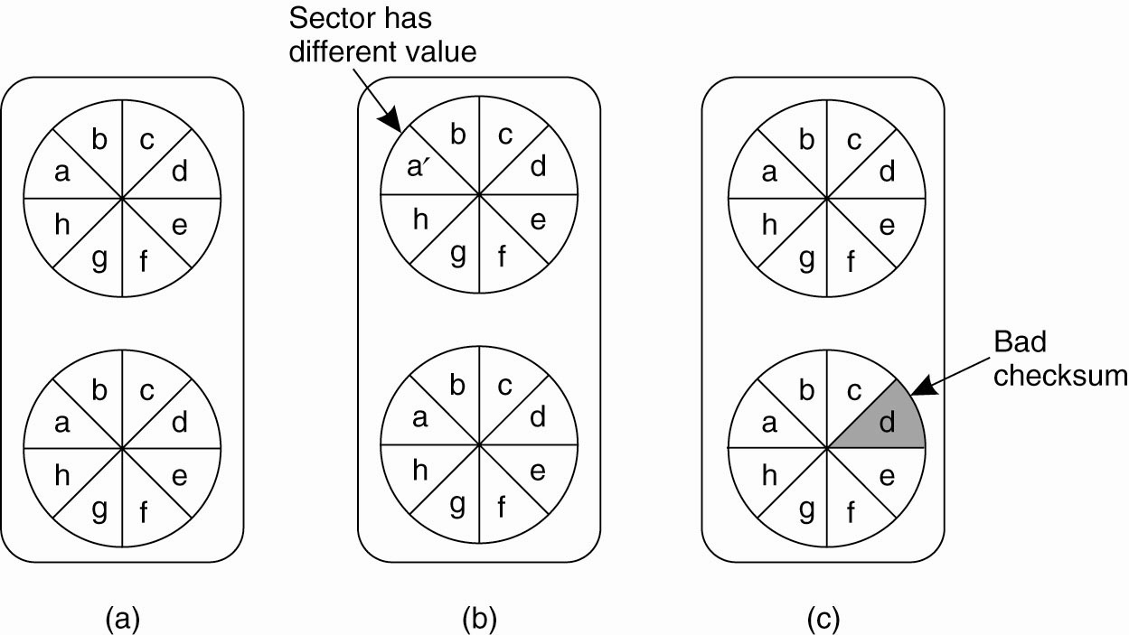
Recovery – Stable Storage
(a) Stable storage. (b) Crash after drive 1 is updated. (c) Bad spot.
Notes:
For any of these schemes to really work, we need this concept of a stable or duable storage. In this example, you have two disks that form a form of durable stoarage where the contents of disk-1 are mirrored to disk-2. (RAID-1).
(b) There was a crash that happened when the data was written to disk1 but before disk2.
(c) Some bit rot happened where “d” had a bad checksum, again you can recover.

Slide 17
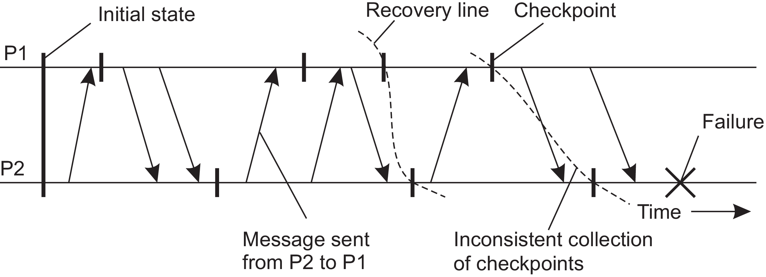
Independent Checkpointing
A recovery line to detect the correct distributed snapshot
This becomes challenging if checkpoints are un-coordinated
Notes:
Recovery in distributed systems is complicated by the fact that processes need to cooperate in identifying a consistent state from where to recover.
In backward recovery, each process will save its state from time to time to local durable storage.

Slide 18
The Domino Effect
Let’s Remove this checkpoint
The domino effect – Cascaded rollback
P2 crashes, roll back, but 2 checkpoints inconsistent (P2 shows m received, but P1 does not show m sent)
Notes:
Same problem continues. You Roll back P2 to the previous checkpoint, but then P1 shows m’ received in its checkpoint, but P2 checkpoint does not show it as sent. Then you have to Roll back P1 to its previous checkpoint,

Slide 19
Coordinated Checkpointing
Key idea: each process takes a checkpoint after a globally coordinated action. (Why?)
Simple Solution: 2-phase blocking protocol
Coordinator multicast checkpoint_REQUEST message
Participants receive message, takes a checkpoint, stops sending (application) messages and queues them, and sends back checkpoint_ACK
Once all participants ACK, coordinator sends checkpoint_DONE to allow blocked processes to go on
Optimization: consider only processes that depend on the recovery of the coordinator (those it sent a message since last checkpoint)
Notes:
Advantage: all processes synchronously write their checkpoints to stable storage, so saved state is automatically globally consistent. Cascaded rollbacks are avoided.

Slide 20
Successful Coord. Checkpoint
Blue: application messages
Red: checkpoint messages

Slide 21
Unsuccessful Coord. Checkpoint
Checkpoints can fail, if participant sent msg before checkpoint_REQUEST
and receiver gets msg after checkpoint_REQUEST. Then: abort and do try
another coordinated checkpoint soon (compare to 2PC).

Slide 22
Today's Lecture Outline
Motivation – Fault Tolerance
Fault Tolerance using Checkpoints
Fault Tolerance using Logging and Recovery
Logging and Recovery in Practice: ARIES
Notes:
Userful References:
https://en.wikipedia.org/wiki/Algorithms_for_Recovery_and_Isolation_Exploiting_Semantics
https://en.wikipedia.org/wiki/Write-ahead_logging
https://en.wikipedia.org/wiki/Shadow_paging

Slide 23
Goal: Make transactions Reliable
…in the presence of failures
Machines can crash: disk contents (OK), memory (volatile)
Assume that machines don’t misbehave
Networks are flaky, packet loss, handle using timeouts
If we store database state in memory, a crash will cause loss of “Durability”.
May violate atomicity, i.e. recover such that uncommited transactions COMMIT or ABORT.
General idea: store enough information to disk to determine global state (in the form of a LOG)

Slide 24
Challenges:
Disk performance is poor (vs memory)
Cannot save all transactions to disk
Memory typically several orders of magnitude faster
Writing to disk to handle arbitrary crash is hard
Several reasons, but HDDs and SSDs have buffers
Same general idea: store enough data on disk so as to recover to a valid state after a crash:
Shadow pages and Write-ahead Logging (WAL)
Idea is to provide Atomicity and Durability
Notes:
Buffers, which are often volatile (again, optimizations for performa
Userful References:
https://en.wikipedia.org/wiki/Algorithms_for_Recovery_and_Isolation_Exploiting_Semantics
https://en.wikipedia.org/wiki/Write-ahead_logging
https://en.wikipedia.org/wiki/Shadow_paging

Slide 25
Shadow Paging Vs WAL
Shadow Pages
Provide Atomicity and Durability, “page” = unit of storage
Idea: When writing a page, make a “shadow” copy
No references from other pages, edit easily!
ABORT: discard shadow page
COMMIT: Make shadow page “real”. Update pointers to data on this page from other pages (recursive). Can be done atomically
Essentially “copy-on-write” to avoid in-place page update
Notes:
Shadow paging is a copy-on-write technique for avoiding in-place updates of pages.

Slide 26
Shadow Paging vs WAL
Write-Ahead-Logging
Provide Atomicity and Durability
Idea: create a log recording every update to database
Updates considered reliable when stored on disk
Updated versions are kept in memory (page cache)
Logs typically store both REDO and UNDO operations
After a crash, recover by replaying log entries to reconstruct correct state
WAL is more common, fewer disk operations, transactions considered committed once log written.

Slide 27
Today's Lecture Outline
Motivation – Fault Tolerance
Fault Tolerance using Checkpoints
Fault Tolerance using Logging and Recovery
Logging and Recovery in Practice: ARIES
Notes:
Userful References:
https://en.wikipedia.org/wiki/Algorithms_for_Recovery_and_Isolation_Exploiting_Semantics
https://en.wikipedia.org/wiki/Write-ahead_logging
https://en.wikipedia.org/wiki/Shadow_paging

Slide 28
ARIES Recovery Algorithms
ARIES: Algorithms for Recovery and Isolation Exploiting Semantics
Used in major databases
IBM DB2 and Microsoft SQL Server
Deals with many practical issues
Principles
Write-ahead logging
Repeating history during Redo
Logging changes during Undo
Notes:
Database organized as set of fixed size PAGES, each of which may have multiple DB records. Manage storage at page level.

Slide 29
Write-Ahead Logging
View as sequence of entries, sequential number
Log-Sequence Number (LSN)
Database: fixed size PAGES, storage at page level
Pages on disk, some also in memory (page cache)
“Dirty pages”: page in memory differs from one on disk
Reconstruct global consistent state using
Log files + disk contents + (page cache)
Logs consist of sequence of records
What do we need to log?
Seq#, which transaction, operation type, what changed…
Notes:
Database organized as set of fixed size PAGES, each of which may have multiple DB records. Manage storage at page level.

Slide 30
Write-Ahead Logging
Logs consist of sequence of records
To record an update to state
LSN: [prevLSN, TID, “update”, pageID, new value, old value]
PrevLSN forms a backward chain of operations for each TID
Storing “old” and “new” values allow REDO operations to bring a page up to date, or UNDO an update reverting to an earlier version
Transaction Table (TT): All TXNS not written to disk
Including Seq Num of the last log entry they caused
Dirty Page Table (DPT): all dirty pages in memory
Modified pages, but not written back to disk.
Includes recoveryLSN: first log entry to make page dirty
Notes:
Reference: https://en.wikipedia.org/wiki/Algorithms_for_Recovery_and_Isolation_Exploiting_Semantics
Database organized as set of fixed size PAGES, each of which may have multiple DB records. Manage storage at page level.
The dirty page table keeps record of all the pages that have been modified and not yet written back to disc and the first Sequence Number that caused that page to become dirty. The transaction table contains all transactions that are currently running and the Sequence Number of the last log entry they caused.
We create log records of the form (Sequence Number, Transaction ID, Page ID, Redo, Undo, Previous Sequence Number). The Redo and Undo fields keep information about the changes this log record saves and how to undo them. The Previous Sequence Number is a reference to the previous log record that was created for this transaction. In the case of an aborted transaction, it's possible to traverse the log file in reverse order using the Previous Sequence Numbers, undoing all actions taken within the specific transaction.

Slide 31
Write-Ahead-Logging
Commit a transaction
Log file up to date until commit entry
Don't update actual disk pages, log file has information
Keep "tail" of log file in memory => not commits
If the tail gets wiped out (crash), then partially executed transactions will lost. Can still recover to reliable state
Abort a transaction
Locate last entry from TT, undo all updates so far
Use PrevLSN to revert in-memory pages to start of TXN
If page on disk needs undo, wait (come back to this)
Notes:
Commit Transaction:
Make sure log file stored to disk up through commit entry. Don't need to update actual disk pages, since log file gives instructions on how to bring them up to date.
Can keep "tail" of log file in memory containing recent entries, but none of them are commits. If the tail gets wiped out (crash), then the partially executed transactions will lost, but can still bring system to reliable state.

Slide 32
Recovery using WAL – 3 passes
Analysis Pass
Reconstruct TT and DPT (from start or last checkpoint)
Get copies of all pages at the start
Recovery Pass (redo pass)
Replay log forward, make updates to all dirty pages
Bring everything to a state at the time of the crash
Undo Pass
Replay log file backward, revert any changes made by transactions that had not committed (use PrevLSN)
For each write Compensation Log Record (CLR)
Once reach entry without PrevLSN → done
Notes:
Analysis[edit]
During the Analysis phase we restore the DPT and the TT as they were at the time of the crash.
We run through the logfile (from the beginning or the last checkpoint) and add all transactions for which we encounter Begin Transaction entries to the TT. Whenever an End Log entry is found, the corresponding transaction is removed. The last Sequence Number for each transaction is of course also maintained.
During the same run we also fill the dirty page table by adding a new entry whenever we encounter a page that is modified and not yet in the DPT. This however only computes a superset of all dirty pages at the time of the crash, since we don't check the actual database file whether the page was written back to the storage.
Recovery. Replay log file forward, making all updates to the dirty pages. Bring everything to state that occurred at time of crash. This involves even executing those transactions that were not yet committed at time of crash. (Required to get consistent state of locks.)
3. Undo. Replay log file backwards, reverting any changes made by transactions that had not committed at time of crash. This is done using the PrevLSN pointers for the uncommitted transactions. Once reach a Begin transaction entry, write an End transaction record to log file.
QUESTION: Why do we write the CLR? To deal with cases where you have a crash during recovery.
The compensation log records make it possible to recover during a crash that occurs during the recovery phase. That isn't as uncommon as one might think, as it is possible for the recovery phase to take quite long. CLRs are read during the Analysis phase and redone during the Redo phase.
How this works: Turns future undo operation into redo operation. E.g., if aborting but copy on disk contains some modifications due to transaction, then CLRs become a record of how to go from that page to one where all updates reverted.

Slide 33
ARIES (WAL): Data Structures
TT: Transaction Table
DPT: Dirty Page Table
TID | LastLSN
1 | 567
2 | 42
7 | 67
2 | 12
pageID | recoveryLSN
42 | 567
46 | 568
77 | 34
3 | 42
TID: Transaction ID
pageID: key/ID of a page
LastLSN: LSN of the most recent log record seen for this
Transaction. i.e. latest change
recoveryLSN: LSN of first log record that made page dirty i.e. earliest change to page
Notes:
Assumptions: the same “page” may contain changes from both “losing” and “winning” transactions.
i.e. two concurrrent transactions may operate on the same page

Slide 34
ARIES: Log Records in Detail
All Log Records
[prevLSN, TID, type]
Update Log Records
[prevLSN, TID, “update”, pageID, redo, undo]
Redo: info on how to redo the change by this rec
Undo: info on how to undo the change by this rec
Compensation Log Records
[prevLSN, TID, “comp”, redoTheUndo, undoNextLSN]
redoTheUnfo: info on how to redo the undo
undoNextLSN: next log record to undo for TXN
Example Ref from: https://www.slideshare.net/ssuser4b58fc/aries-55987958

Slide 35
Example Log File
LSN: [prevLSN, TID, type] # All
LSN: [prevLSN, TID, “update”, pageID, redo, undo] # Update
TT
TID | LastLSN
DB Buffer
LOG
Page 42
LSN=-
a=77
b=55
DPT
pageID | recoveryLSN
Page 46
LSN=-
c=22
Notes:
Assume initial values as: a=77, b=55, c=22
Assume the two transactions are:
1: a=a+1; b=b+1
2: b=b+3; c=c+2

Slide 36
Example Log File
LSN: [prevLSN, TID, type] # All
LSN: [prevLSN, TID, “update”, pageID, redo, undo] # Update
TT
TID | LastLSN
1 | 1
DB Buffer
LOG
Page 42
1: [-,1,”update”,42,a+=1, a-=1]
LSN=1
a=78
b=55
DPT
pageID | recoveryLSN
42 | 1
Page 46
LSN=-
c=22

Slide 37
Example Log File
LSN: [prevLSN, TID, type] # All
LSN: [prevLSN, TID, “update”, pageID, redo, undo] # Update
TT
TID | LastLSN
1 | 1
2 | 2
DB Buffer
LOG
Page 42
1: [-,1,”update”,42,a+=1, a-=1
2: [-,2,”update”, 42,b+=3, b-=3]
LSN=2
a=78
b=58
DPT
pageID | recoveryLSN
42 | 1
Page 46
LSN=-
c=22

Slide 38
Example Log File
LSN: [prevLSN, TID, type] # All
LSN: [prevLSN, TID, “update”, pageID, redo, undo] # Update
TT
TID | LastLSN
1 | 4
2 | 3
DB Buffer
LOG
Page 42
1: [-,1,”update”,42,a+=1, a-=1
2: [-,2,”update”, 42,b+=3, b-=3]
3: [2,2,”update”,46,c+=2, c-=2]
4:[1,1,”update”,42, b+=1, b-=1]
LSN=4
a=78
b=59
DPT
pageID | recoveryLSN
42 | 1
46 | 3
Page 46
LSN=3
c=24

Slide 39
Example Log File
LSN: [prevLSN, TID, type] # All
LSN: [prevLSN, TID, “update”, pageID, redo, undo] # Update
TT
TID | LastLSN
1 | 4
DB Buffer
LOG
Page 42
1: [-,1,”update”,42,a+=1, a-=1
2: [-,2,”update”, 42,b+=3, b-=3]
3: [2,2,”update”,46,c+=2, c-=2]
4:[1,1,”update”,42, b+=1, b-=1]
5:[3,2,”commit”]
LSN=4
a=78
b=59
DPT
pageID | recoveryLSN
42 | 1
46 | 3
Page 46
LSN=3
c=24

Slide 40
Example Log File
LSN: [prevLSN, TID, type] # All
LSN: [prevLSN, TID, “update”, pageID, redo, undo] # Update
LSN: [prevLSN, TID, “comp”, redoTheUndo, undoNextLSN] #compensation
On Disk
LOG
Page 42
1: [-,1,”update”,42,a+=1, a-=1
2: [-,2,”update”, 42,b+=3, b-=3]
3: [2,2,”update”,46,c+=2, c-=2]
4:[1,1,”update”,42, b+=1, b-=1]
5:[3,2,”commit”]
LSN=-
a=77
b=55
Page 46
LSN=-
c=22
Notes:
Crash happened.

Slide 41
Example Log File
LSN: [prevLSN, TID, type] # All
LSN: [prevLSN, TID, “update”, pageID, redo, undo] # Update
LSN: [prevLSN, TID, “comp”, redoTheUndo, undoNextLSN] #compensation
TT
TID | LastLSN
1 | 4
On Disk
LOG
1. Analysis
Page 42
1: [-,1,”update”,42,a+=1, a-=1
2: [-,2,”update”, 42,b+=3, b-=3]
3: [2,2,”update”,46,c+=2, c-=2]
4:[1,1,”update”,42, b+=1, b-=1]
5:[3,2,”commit”]
LSN=-
a=77
b=55
DPT
pageID | recoveryLSN
42 | 1
46 | 3
Page 46
LSN=-
c=22
1. Analysis to figure out the start of the redo. => start from 1
Notes:
Crash happened.

Slide 42
Example Log File
LSN: [prevLSN, TID, type] # All
LSN: [prevLSN, TID, “update”, pageID, redo, undo] # Update
LSN: [prevLSN, TID, “comp”, redoTheUndo, undoNextLSN] #compensation
Analysis
Redo
TT
TID | LastLSN
1 | 4
DB Buffer
LOG
Page 42
1: [-,1,”update”,42,a+=1, a-=1
2: [-,2,”update”, 42,b+=3, b-=3]
3: [2,2,”update”,46,c+=2, c-=2]
4:[1,1,”update”,42, b+=1, b-=1]
5:[3,2,”commit”]
LSN=4
a=78
b=59
DPT
pageID | recoveryLSN
42 | 1
46 | 3
Page 46
LSN=3
c=24
Notes:
Crash happened.

Slide 43
Example Log File
LSN: [prevLSN, TID, type] # All
LSN: [prevLSN, TID, “update”, pageID, redo, undo] # Update
LSN: [prevLSN, TID, “comp”, redoTheUndo, undoNextLSN] #compensation
Analysis
Redo
Undo
TT
TID | LastLSN
1 | 6
DB Buffer
LOG
Page 42
1: [-,1,”update”,42,a+=1, a-=1
2: [-,2,”update”, 42,b+=3, b-=3]
3: [2,2,”update”,46,c+=2, c-=2]
4:[1,1,”update”,42, b+=1, b-=1]
5:[3,2,”commit”]
LSN=6
a=78
b=58
DPT
pageID | recoveryLSN
42 | 1
46 | 3
Page 46
6: [4,1,”comp”,42,b-=1, b+=1]
LSN=3
c=24
Notes:
Crash happened.

Slide 44
Example Log File
LSN: [prevLSN, TID, type] # All
LSN: [prevLSN, TID, “update”, pageID, redo, undo] # Update
LSN: [prevLSN, TID, “comp”, redoTheUndo, undoNextLSN] #compensation
Analysis
Redo
Undo
TT
TID | LastLSN
1 | 7
DB Buffer
LOG
Page 42
1: [-,1,”update”,42,a+=1, a-=1
2: [-,2,”update”, 42,b+=3, b-=3]
3: [2,2,”update”,46,c+=2, c-=2]
4:[1,1,”update”,42, b+=1, b-=1]
5:[3,2,”commit”]
LSN=7
a=77
b=58
DPT
pageID | recoveryLSN
42 | 1
46 | 3
Page 46
6: [4,1,”comp”,42,b-=1, b+=1]
7: [6,1,”comp”, 42, a-=1, a+=1]
LSN=3
c=24
Notes:
Crash happened.

Slide 45
2PC works great with WAL/ARIES
WAL can integrate with 2PC
Have additional log entries that capture 2PC operation
Coordinator: Include list of participants
Participant: Indicates coordinator
Votes to commit or abort
Indication from coordinator to Commit/Abort

Slide 46
Optimizing WAL
As described earlier:
Replay operations back to the beginning of time
Log file would be kept forever (→ entire Database)
In practice, we can do better with CHECKPOINT
Periodically save DPT, TT
Store any dirty pages to disk, indicate in LOG file
Prune initial portion of log file: All transactions upto checkpoint have been committed or aborted.

Slide 47
Summary
Basic concepts for Fault Tolerant Systems
Properties of dependable systems
Redundancy, process resilience (see T8.2)
Reliable RPCs (see T8.3)
Fault Tolerance – Backward recovery using checkpoints.
Tradeoff: independent vs coordinated checkpointing
Fault Tolerance –Recovery using Write-Ahead-Logging
Balances the overhead of checkpointing and ability to recover to a consistent state

Slide 48
Additional Material in the Book
Process Resilience (when processes fail) T8.2
Have multiple processes (redundancy)
Group them (flat, hierarchically), voting
Reliable RPCs (communication failures) T8.3
Several cases to consider (lost reply, client crash, …)
Several potential solutions for each case
Distributed Commit Protocols T8.5
Perform operations by all group members, or not at all
2 phase commit, … (last lecture)
Logging and recovery T8.6

