Slide 1
15-440 Distributed Systems
Lecture 09 – Distributed Concurrency Management
The Two Phase Commit Protocol
Thursday, September 27th, 2018

Slide 2
Logistics Updates
P1 Part A checkpoint ( was due 9/25)
Part A due: Saturday 10/6 (6-week drop deadline 10/8)
Part B due: Tuesday 10/16
HW2 will be released 10/01
HW 2 due: Friday, 10/10 (tentative, maybe 10/12)
(*No Late Days*) => time to prepare for Mid term
We’re currently grading HW1
HW1 solutions should come online soon

Slide 3
Today's Lecture Outline
Transactions and Consistency
Database terminology
Part I: Single Server Case
(not covered well in book)
Two Phase Locking
Part II: Distributed Transactions
Two Phase Commit (Tanenbaum 8.5)

Slide 4
Assumptions for Today
Ignore failures in first half
Concurrency is our main concern
To deal with failures
Assume a form of logging, where every machine writes information down *before* operating on it, to recover from simple failures. Recover after failure.
Next lecture: Logging and Crash Recovery

Slide 5
Database transactions
Background: Database Researchers
Defined: “Transactions”
Collections of Reads + Writes to Global State
Appear as a single, “indivisible” operation
Standard Models for Reliable Storage (visit later)
Desirable Characteristics of Transactions
Atomicity, Consistency, Isolation, Durability
Also referred to as the “ACID” Acronym!
Notes:
Database researchers laid the background for reasoning about how to process a number of concurrent events that update some shared global state. They invented the concept of a "transaction" in which a collection of reads and writes of a global state are bundled such that they appear to be single, indivisible operation. (They also defined standard models for reliable storage and for robust operation. We'll visit those later.)

Slide 6
Transactions: ACID Properties
Atomicity: Each transaction completes in its entirely, or is aborted. If aborted, should not have have effect on the shared global state.
Example: Update account balance on multiple servers
Consistency: Each transaction preserves a set of invariants about global state. (Nature of invariants is system dependent).
Example: in a bank system, law of conservation of $$
Notes:
Atomicity: Each transaction is either completed in its entirety, or aborted. In the latter case, it should have no effect on the global state.
Example: Update account balance on multiple servers ➔ So either the transaction happens as an single transaction on all servers, or not at all.
Consistency: Each transaction preserves a set of invariants about the global state. The exact nature of these is system dependent. *Warning*: The "C" here makes a great acronym, but the term "consistency" is used differently in distributed systems when referring to operations across multiple processors. Beware this gotcha -- this "C" is an application or database-specific idea of maintaining the self-consistency of the data.
Example: For the bank case, the invariant that must be true before and after the transaction is that the total amount of money must remain the same.

Slide 7
Transactions: ACID Properties
Isolation: Also means serializability. Each transaction executes as if it were the only one with the ability to RD/WR shared global state.
Durability: Once a transaction has been completed, or “committed” there is no going back. In other words there is no “undo”.
Transactions can also be nested
“Atomic Operations” => Atomicity + Isolation
Notes:
Isolation: Also means that if there are two of more transactions running at the same time, to each of them and to other processes, the final result looks like the transactions ran in some sequential order (the order itself may be system dependent).
Durability: Also implies that no failure after the commit can undo the results or cause the results to be lost.
Interestingly, transactions be be deeply nested (subtansactions within transactions) but the semantics are clear. When a transactions or subtransaction starts its given a private copy of the all data in the system for it to manipulate. However, if it aborts its private data and changes vanishes. If it commits, then its private universe replaces the parents universe and the changes are made durable.

Slide 8
A Transaction Example: Bank
Array Bal[i] stores balance of Account “i”
Implement: xfer, withdraw, deposit
withdraw(i, v):
b = Bal[i] // Read if b >= v // Test Bal[i] = b-v // Write return true
else
return false
xfer(i, j, v):
if withdraw(i, v):
deposit(j, v)
else abort
deposit(j, v):
Bal[j] += v

Slide 9
A Transaction Example: Bank
xfer(i, j, v):
if withdraw(i, v):
deposit(j, v)
else abort
withdraw(i, v):
b = Bal[i] // Read if b >= v // Test Bal[i] = b-v // Write return true
else
return false
deposit(j, v):
Bal[j] += v
Imagine: Bal[x] = 100, Bal[y]=Bal[z]=0
Two transactions => T1:xfer(x,y,60), T2: xfer(x,z,70)
ACID Properties: T1 or T2 in some serial order
T1; T2: T1 succeeds; T2 Fails. Bal[x]=40, Bal[y]=60
T2; T1: T2 succeeds; T1 Fails. Bal[x]=30, Bal[z]=70
What if we didn’t take care? Is there a race condition?
Updating Bal[x] with Read/Write interleaving of T1,T2
Notes:
Question: So, what will happen if they follow ACID properties and happen in some serial order?
Question: What if we didn’t take care? Is there a race condition?
Answer: Race condition when updating value of Bal[x]. If the transactions interleave between Read and Writes of each action?
Bal[x] could be either 30 or 40 but both transactions could happen!
ACID Violation: Not Isolated, and not Consistent

Slide 10
A Transaction Example: Bank
xfer(i, j, v):
if withdraw(i, v):
deposit(j, v)
else abort
withdraw(i, v):
b = Bal[i] // Read if b >= v // Test Bal[i] = b-v // Write return true
else
return false
sumbalance(i, j, k): return Bal[i]+Bal[j]+ Bal[k]
deposit(j, v):
Bal[j] += v
Imagine: Bal[x] = 100, Bal[y]=Bal[z]=0
Two transactions => T1:xfer(x,y,60), T2: xfer(x,z,70)
ACID violation: Not Isolated, Not Consistent
Updating Bal[x] with Read/Write interleaving of T1,T2
Bal[x] = 30 or 40; Bal[y] = 60; Bal [z] = 70
For Consistency, implemented sumbalance()
State invariant sumbalance=100 violated! We created $$
Notes:
Question: So, what will happen if they follow ACID properties and happen in some serial order?
Question: What if we didn’t take care? Is there a race condition?
Answer: Race condition when updating value of Bal[x]. If the transactions interleave between Read and Writes of each action?
Bal[x] could be either 30 or 40 but both transactions could happen!
ACID Violation: Not Isolated, and not Consistent (create more money than we had!)

Slide 11
Implement transactions with locks
Use locks to wrap xfer
xfer(i, j, v):
lock()
if withdraw(i, v):
deposit(j, v)
else abort
unlock()
xfer(i, j, v):
lock(i)
if withdraw(i, v):
unlock(i) lock(j)
deposit(j, v) unlock(j)
else unlock(i) abort
However, is this the correct approach? (Hint: efficiency)
Is this fixed then?
Sequential bottleneck due to global lock. Solution?
No, consistency violation. sumbalance() after unlock(i)
Notes:
Is this the right approach? No, sequential bottleneck since global lock across all acounts!
No, consistency violation. sumbalance() after unlock(i)
WHY? Releasing lock i early can give consistency violation. Some other transaction (e.g., sumbalance) could see decremented value of account i, but unincremented value of count j.

Slide 12
Implement transactions with locks
Fix: Release locks when update
of all state variables complete.
xfer(i, j, v):
lock(i)
if withdraw(i, v):
lock(j)
deposit(j, v) unlock(i); unlock(j)
else unlock(i) abort
Are we done then?
Nope, deadlock.
Bal[x]=Bal[y]=100 xfer(x,y,40) and
xfer (y, x, 30)

Slide 13
Implement transactions with locks
Insight: Need unique global order for acquiring locks.
xfer(i, j, v):
lock(min(i,j); lock(max (i,j))
if withdraw(i, v):
deposit(j, v) unlock(i); unlock(j)
else unlock(i); unlock(j) abort
This works. :)
Motivation for 2-Phase Locking

Slide 14
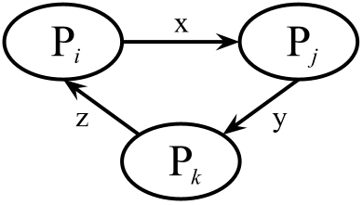
Acquiring Locks in a Unique Order
Consider “Wait-for” graph for state of locks
Vertices represent transactions
Edge from vertex i to vertex j if transaction i is waiting for lock held by transaction j.
What does a cycle mean?
Can a cycle occur if we acquire locks in unique order?
No. Label edges with its lock ID. For any cycle, there must be some pair of edges (i, j), (j, k) labeled with values x & y. As k holds y, but waits for x: y<x.
Transaction j is holding lock x and it wants lock y, so y > x.
Implies that j is not acquiring its lock in proper order.
General scheme: 2-phase locking
More precisely: strong strict two phase locking
Notes:
Recall, we wanted the locks with the lower ID to be acquired first.

Slide 15
2-Phase Locking Variant
General 2-phase locking
Phase 1: Acquire or Escalate Locks (e.g. read => write)
Phase 2: Release or de-escalate lock
Strict 2-phase locking
Phase 1: (same as before)
Phase 2: Release WRITE lock at end of transaction only
Strong Strict 2-phase locking
Phase 1: (same as before)
Phase 2: Release ALL locks at end of transaction only.
Most common version, required for ACID properties
Notes:
General 2-phase locking
Phase 1. Acquire or escalate locks (e.g., read lock to write lock)
Phase 2. Release or deescalate locks
Strict 2-phase locking
During Phase 2. Release WRITE locks only at end of transactions
Strong strict 2-phase locking
During Phase 2. Release ALL locks only at end of transactions.
This is the most common version. Required to provide ACID properties.

Slide 16
2-Phase Locking
Why not always use strong-strict 2-phase locking?
A transaction may not know the locks it needs in advance
if Bal(yuvraj) < 100:
x = find_richest_prof()
transfer_from(x, yuvraj)
Other ways to handle deadlocks
Lock manager builds a “waits-for” graph. On finding a cycle, choose offending transaction and force abort
Use timeouts: Transactions should be short. If hit time limit, find transaction waiting for a lock and force abort.

Slide 17
Transactions – split into 2 phases
Phase 1: Preparation:
Determine what has to be done, how it will change state, without actually altering it.
Generate Lock set “L”
Generate List of Updates “U”
Phase 2: Commit or Abort
Everything OK, then update global state
Transaction cannot be completed, leave global state as is
In either case, RELEASE ALL LOCKS
Notes:
Preparation. Figure out what to do and how it will change state, without altering state. Generate L: Set of locks, and U: List of updates
2. Commit or abort.
If everything OK, then update global state.
If transaction cannot be completed, leave global state unchanged.
In either case, release all locks

Slide 18
Example
xfer(i, j, v):
L={i,j} // Locks
U=[] //List of Updates
begin(L) //Begin transaction, Acquire locks
bi = Bal[i]
bj = Bal[j]
if bi >= v:
Append(U,Bal[i] <- bi – v)
Append(U, Bal[j] <- bj + v) commit(U,L)
else abort(L)
Question: So, what would “commit” and ”abort” look like?
commit(U,L):
Perform all updates in U
Release all locks in L
abort(L): Release all locks in L
Notes:
Question: what would the two functions commit() and abort() look like?

Slide 19
Today's Lecture Outline
Consistency for multiple-objects, multiple-servers
Part I: Single Server Case
(not covered well in book)
Two Phase Locking
Part II: Distributed Transactions
Two Phase Commit (Tanenbaum 8.6)

Slide 20
Distributed Transactions?
Partition databases across multiple machines for scalability
(E.g., machine 1 responsible for account i, machine 2 responsible for account j)
Transaction often touch more than one partition
How do we guarantee that all of the partitions commit the transactions or none commit the transactions?
Transferring money from i to j.
Requirement: both banks/machines do it, or neither

Slide 21
Enabling Distributed Transactions
Similar idea as before, but:
State spread across servers (maybe even WAN)
Failures
Overall Idea:
Client initiates transaction. Makes use of “coordinator”
All other relevant servers operate as “participants”
Coordinator assigns unique transaction ID (TID)
Strawman solution
2-phase commit protocol
Notes:
Note, co-ordinator could even be the client itself.

Slide 22
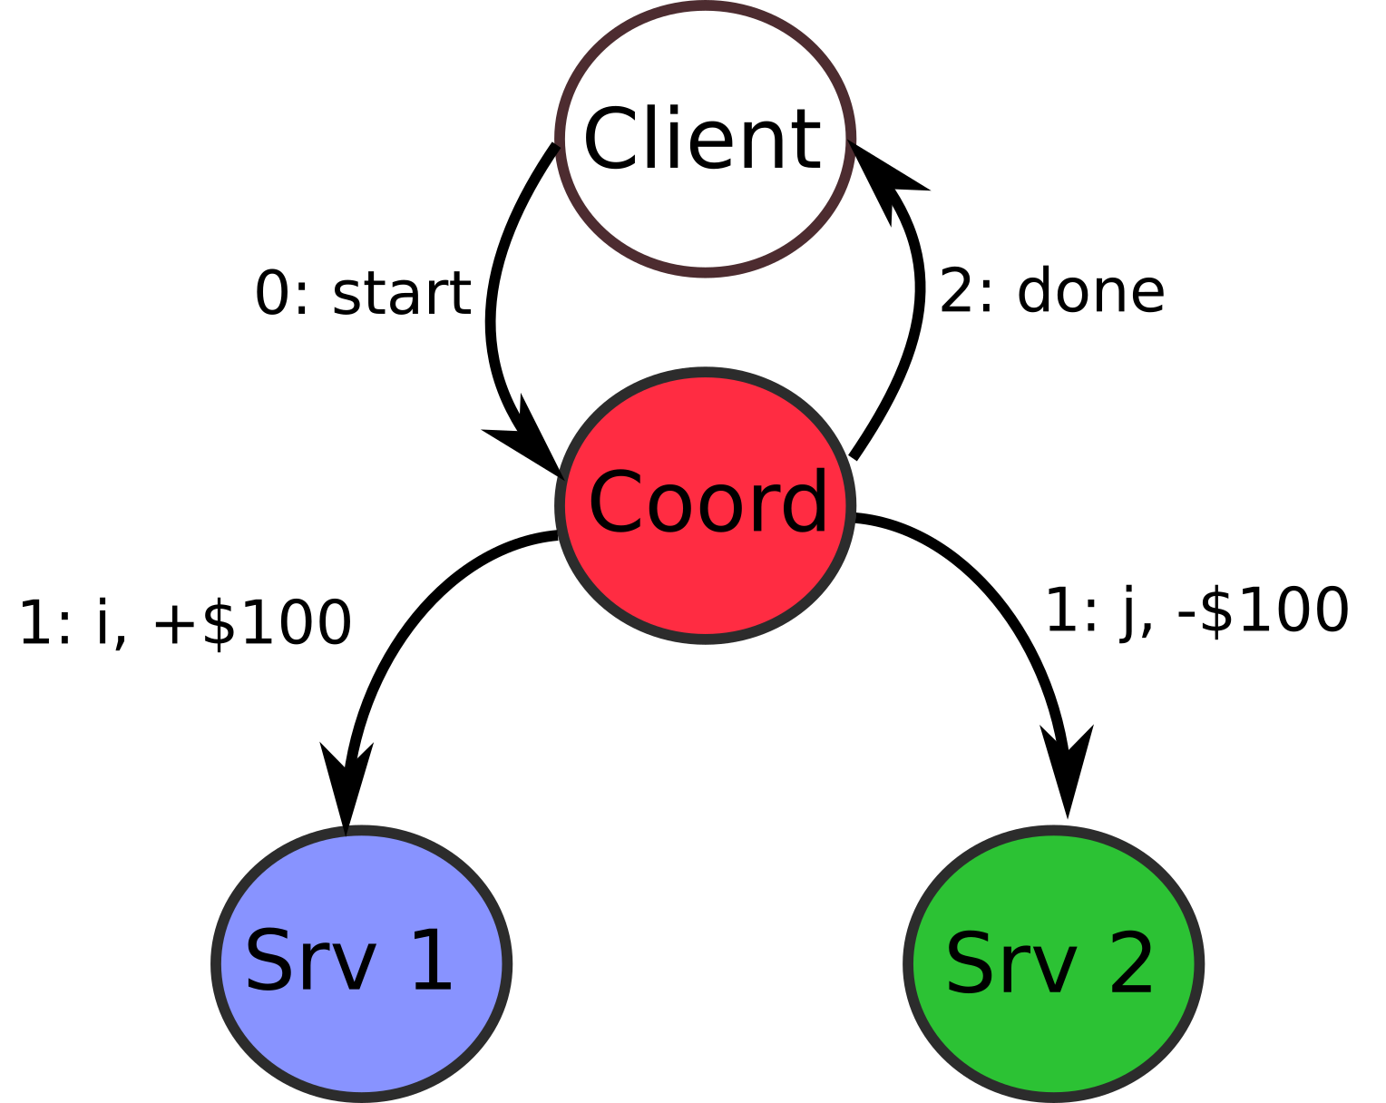
Strawman solution
Even without failures, a lot can go wrong
Account j on Srv 2 has only $90
Account j doesn’t exist!
Violates which part of ACID

Slide 23
2-Phase Commit
Phase 1: Prepare & Vote
Participants figure out all state changes
Each determines if it can complete the transaction
Communicate with coordinator
Phase 2: Commit
Coordinator broadcasts to participants: COMMIT / ABORT
If COMMIT, participants make respective state changes

Slide 24
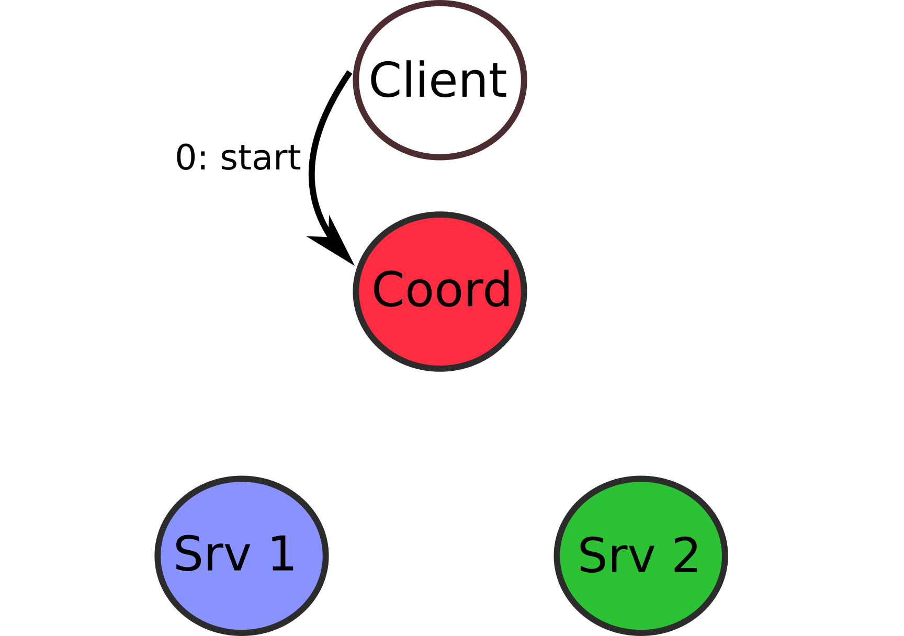
Implementing 2-Phase Commit
Implemented as a set of messages
Notes:
Note: This requires that nodes be able to abort or carry forward their changes. This is accomplished with _logging_. (next lecture)

Slide 25
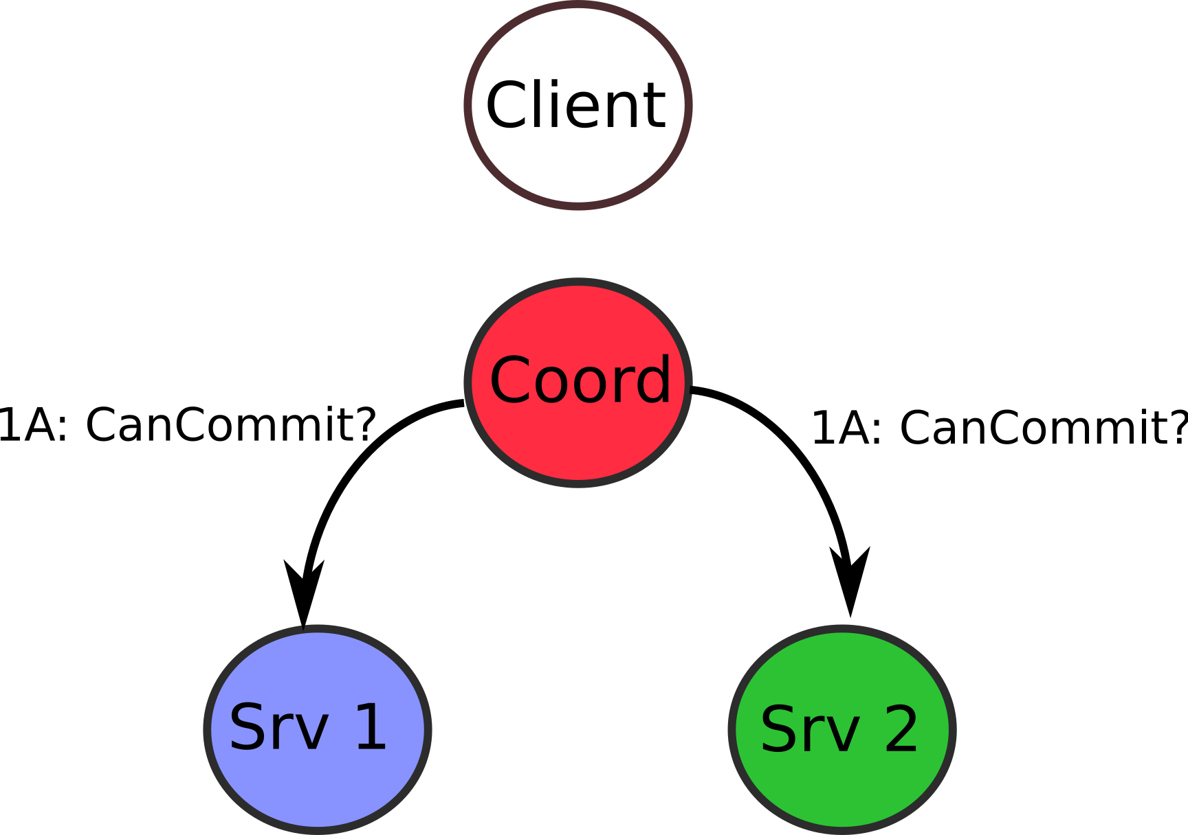
Implementing 2-Phase Commit
Implemented as a set of messages
Messages in first phase
A: Coordinator sends “CanCommit?” to participants
Notes:
Note: This requires that nodes be able to abort or carry forward their changes. This is accomplished with _logging_. (next lecture)

Slide 26
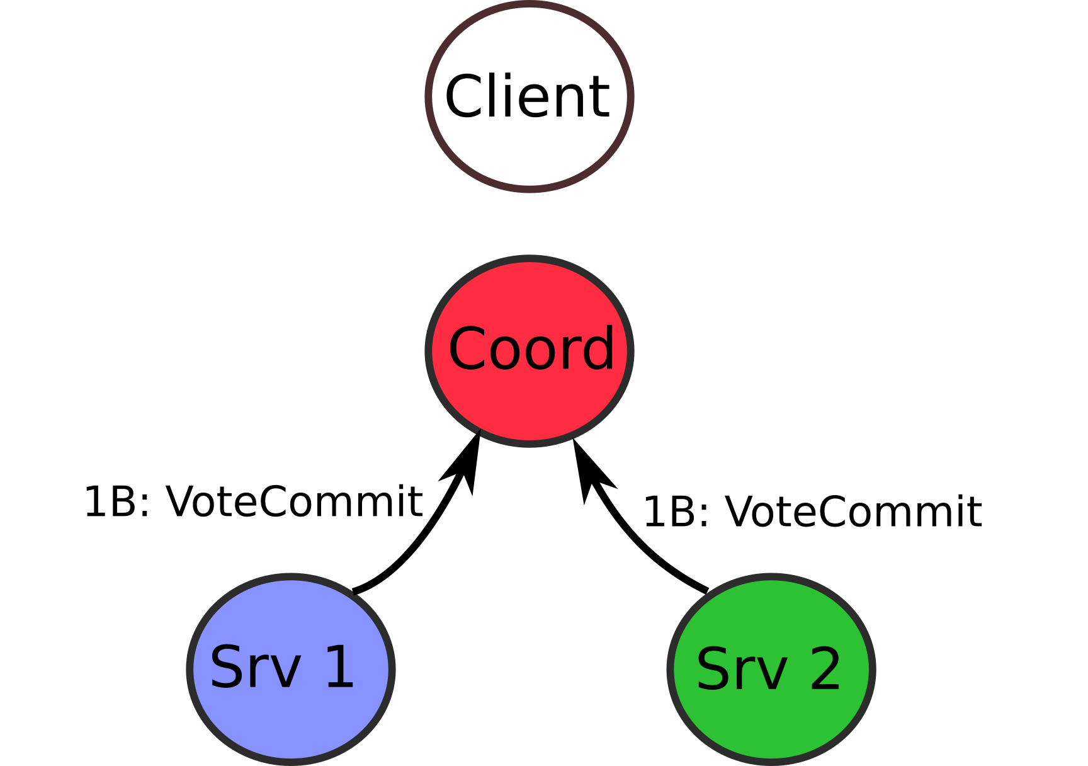
Implementing 2-Phase Commit
Implemented as a set of messages
Messages in first phase
A: Coordinator sends “CanCommit?” to participants
B: Participants respond: “VoteCommit” or “VoteAbort”
Notes:
Note: This requires that nodes be able to abort or carry forward their changes. This is accomplished with _logging_. (next lecture)

Slide 27
Implementing 2-Phase Commit
Implemented as a set of messages
Messages in first phase
A: Coordinator sends “CanCommit?” to participants
B: Participants respond: “VoteCommit” or “VoteAbort”
Messages in the second phase
A: All “VoteCommit”: , Coord sends “DoCommit”
If any “VoteAbort”: abort transaction. Coordinator sends “DoAbort” to everyone => release locks
Notes:
Note: This requires that nodes be able to abort or carry forward their changes. This is accomplished with _logging_. (next lecture)

Slide 28
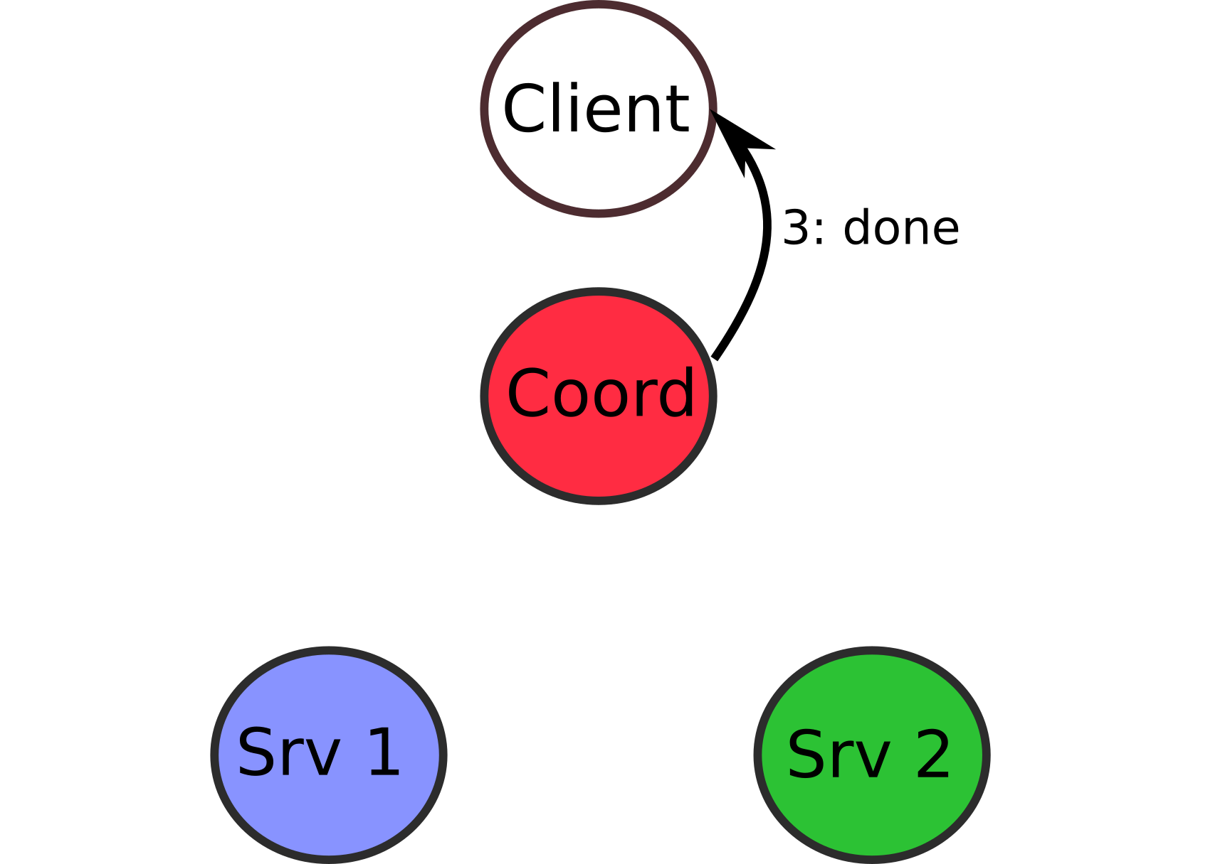
Implementing 2-Phase Commit
Implemented as a set of messages
Messages in first phase
A: Coordinator sends “CanCommit?” to participants
B: Participants respond: “VoteCommit” or “VoteAbort”
Messages in the second phase
A: All “VotedCommit”: , Coord sends “DoCommit”
If any “VoteAbort”: abort transaction. Coordinator sends “DoAbort” to everyone => release locks
Notes:
Note: This requires that nodes be able to abort or carry forward their changes. This is accomplished with _logging_. (next lecture)

Slide 29
Example for 2PC
Bank Account “i” at Server 1, “j” at Server 2.
L={i}
Begin(L) // Acq. Locks
U=[] //List of Updates
b=Bal[i]
if b >= v:
Append(U, Bal[i] <- b – v)
vote commit
else
vote abort
L={j}
Begin(L) // Acq. Locks
U=[] //List of Updates
b=Bal[j]
Append(U, Bal[j] <- b + v)
vote commit
Server 2 implements transaction
Server 1 implements transaction
Server 2 can assume that the account of “i” has enough money, otherwise whole transaction will abort.
What about locking? Locks held by individual participants
- Acquire lock at start of prep process, release at Commit/Abort

Slide 30
Properties of 2-Phase Commit
Correctness
Neither can commit unless both agreed to commit
Performance
3N messages per transaction
How to handle failure?
Timeouts → performance bad in case of failure!

Slide 31
Deadlocks and Livelocks
Distributed deadlock
Cyclic dependency of locks by transactions across servers
In 2PC this can happen if participants unable to respond to voting request (e.g. still waiting on a lock on its local resource)
Handled with a timeout. Participants times out, then votes to abort. Retry transaction again.
Addresses the deadlock concern
However, danger of LIVELOCK – keep trying!

Slide 32
Timeout and Failure Cases 1
Coordinator times out after “CanCommit?”
Hasn’t sent any commit messages, safely abort
Conservative. Why?
Preserve correctness, sacrifice performance
Participant times out after “VoteAbort”
Can safely abort unilaterally.
Why?

Slide 33
Timeout and Failure Cases 2
Participant times out after “VoteCommit”
Are unilateral decisions possible? Commit, Abort?
Participant could wait forever
Solution: ask another participant (gossip protocol)
Learn coordinator’s decision: do the same
Assumption: non-Byzantine failure model
Other participant hasn’t voted: abort is safe. Why?
Coordinator has not made decision
No reply or other participant also “VoteCommit”: wait
2PC is “blocking protocol” → 3PC in book.

Slide 34
2 Phase Commit in Practice
2PC widely used in practice
Logging and Crash Recovery
Crucial to handle crashes / reboots (next lecture)
Very powerful and resilient when paired with RAID (3 lectures from now)
NDB Cluster

Slide 35
Summary
Distributed consistency management
ACID Properties desirable
Single Server case: use locks + 2-phase locking (strict 2PL, strong strict 2PL), transactional support for locks
Multiple server distributed case: use 2-phase commit for distributed transactions. Need a coordinator to manage messages from participants
2PC can become a performance bottleneck

Slide 36
Additional Material
Overview:
2PC notation from the Book
Terminology used by messages different, but essentially the protocol is the same
Pointers to 3PC (fully described in the book)

Slide 37
Two-Phase Commit (1)
(a) The finite state machine for the coordinator in 2PC. (b) The finite state machine for a participant.
Coordinator/Participant can be blocked in 3 states:
Participant: Waiting in INIT state for VOTE_REQUEST
Coordinator: Blocked in WAIT state, listening for votes
Participant: blocked in READY state, waiting for global vote

Slide 38
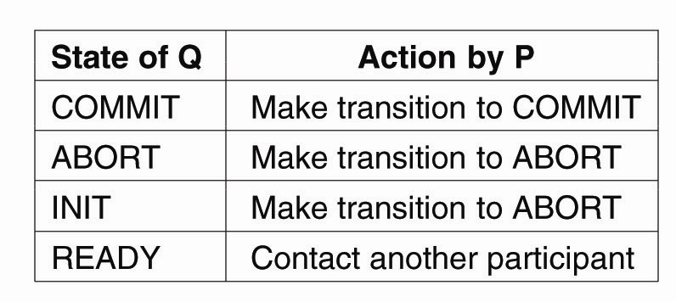
Two-Phase Commit (2)
What if a “READY” participant does not receive the global commit? Can’t just abort => figure out what message a co-ordinator may have sent.
Approach: ask other partcipants
Take actions on response on any of the participants
E.g. P is in READY state, asks other “Q” participants
What happens if everyone is in ”READY” state?
Notes:
If everyone is in ”READY” state then protocol blocks for co-ordinator (e.g. if the co-ordinator is unresponsive or has crashed!).

Slide 39
Two-Phase Commit (3)
For recovery, must save state to persistent storage (e.g. log), to restart/recover after failure.
Participant (INIT): Safe to local abort, inform Coordinator
Participant (READY): Contact others
Coordinator (WAIT): Retransmit VOTE_REQ
Coordinator (WAIT/Decision): Retransmit VOTE_COMMIT
Notes:
Coordinator has to be careful about tracking two states:
If it recorded that it entered wait state and not all responses came back, it can just resent the VOTE_REQ
If it reconded that it had come to a decision in the 2nd phase already, then that decision must be recorded and just be retransmitted.

Slide 40
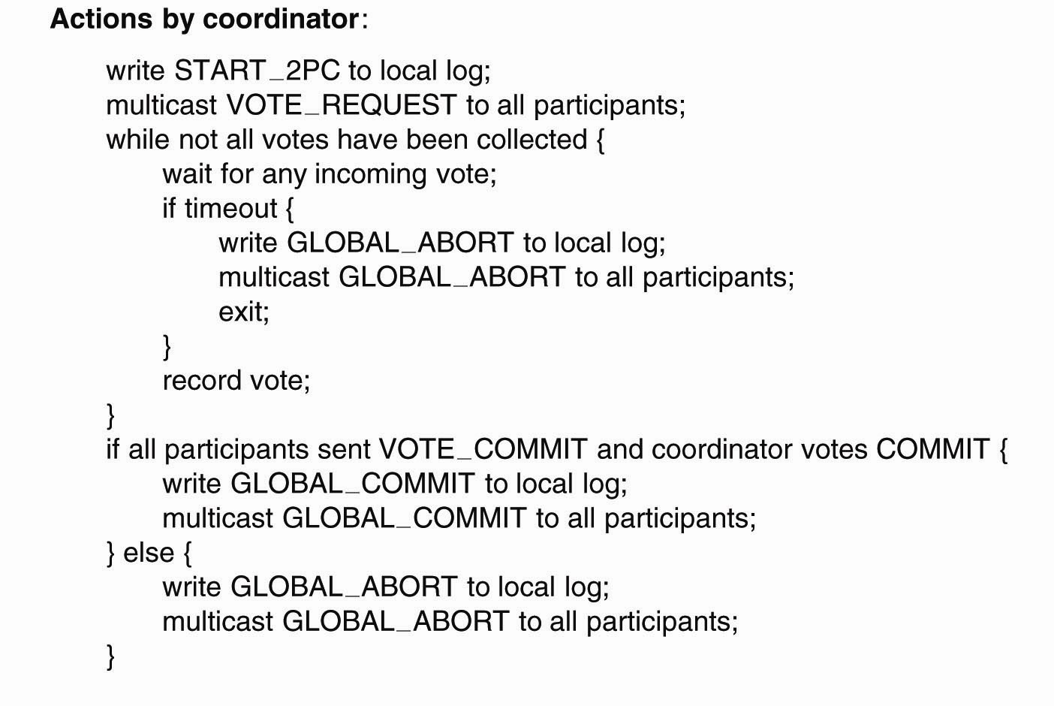
2PC: Actions by Coordinator
Why do we have the ”write to LOG” statements?
Notes:
Why do we have the ”write to LOG” statements?
Ans: Needed for recovery as mentioned earlier

Slide 41
2PC: Actions by Participant
Wait for REQUESTS
If Decision to COMMIT
LOG=>Send=> Wait
No response? Ask others
If global decision, COMMIT OR ABORT
Else, Local Decision
LOG => send

Slide 42
2PC: Handling Decision Request
Note, participant can only help others if it has reached a global decision and committed it to its log.
What if everyone has received VOTE_REQ, and Co-ordinator crashes?
Notes:
What if everyone has received VOTE_REQ, and Co-ordinator crashes?
DEADLOCK: Use 3PC

Slide 43
Three-Phase Commit (1)
The states of the coordinator and each participant
satisfy the following two conditions:
There is no single state from which it is possible to make a transition directly to either a COMMIT or an ABORT state.
There is no state in which it is not possible to make a final decision, and from which a transition to a COMMIT state can be made.

Slide 44
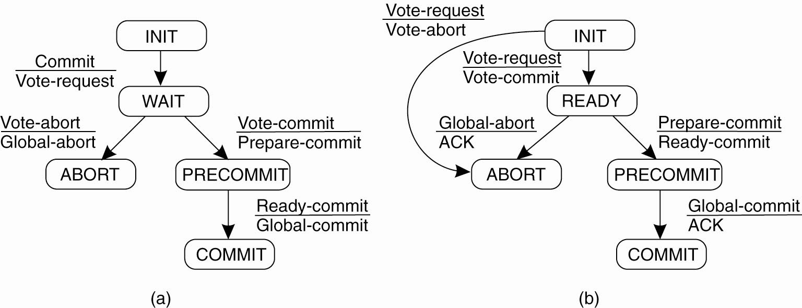
Three-Phase Commit (2)
Figure 8-22. (a) The finite state machine for the coordinator in 3PC. (b) The finite state machine for a participant.

Slide 45
3PC – Resolution in case of failures
Can always get back to a known state
If any Participant Q in INIT: Safe to abort. This is because A can be in INIT only if no other participant is in PRECOMMIT i
If All participants are in READY: Abort. Since if P has crashed and recovers later, neither P nor others know what the state of P might be on recovery. If P recovers to INIT, Abort is fine. Even if PRECOMMIT, abort is OK.
Different to 2PC where a crashed participant can recover to a COMMIT state, while others in READY. In 3PC if a operational process is in READY, no other crashed process can recover to state other than INIT, ABORT, PRECOMMIT
If Processes that P can contact are in PRECOMMIT, then safe to COMMIT

